Slide 1
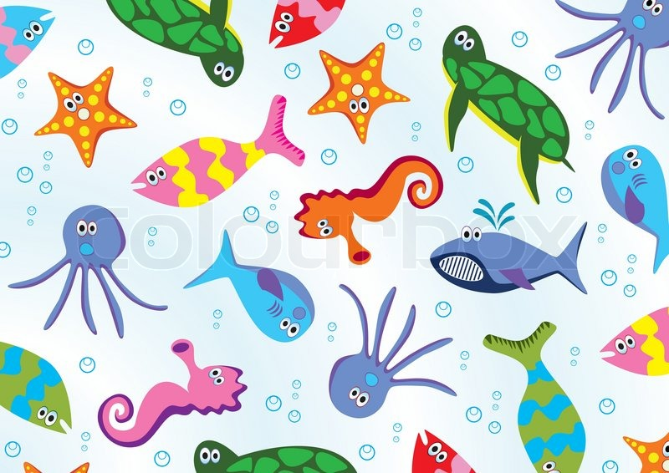
Animals that live in water

Slide 2
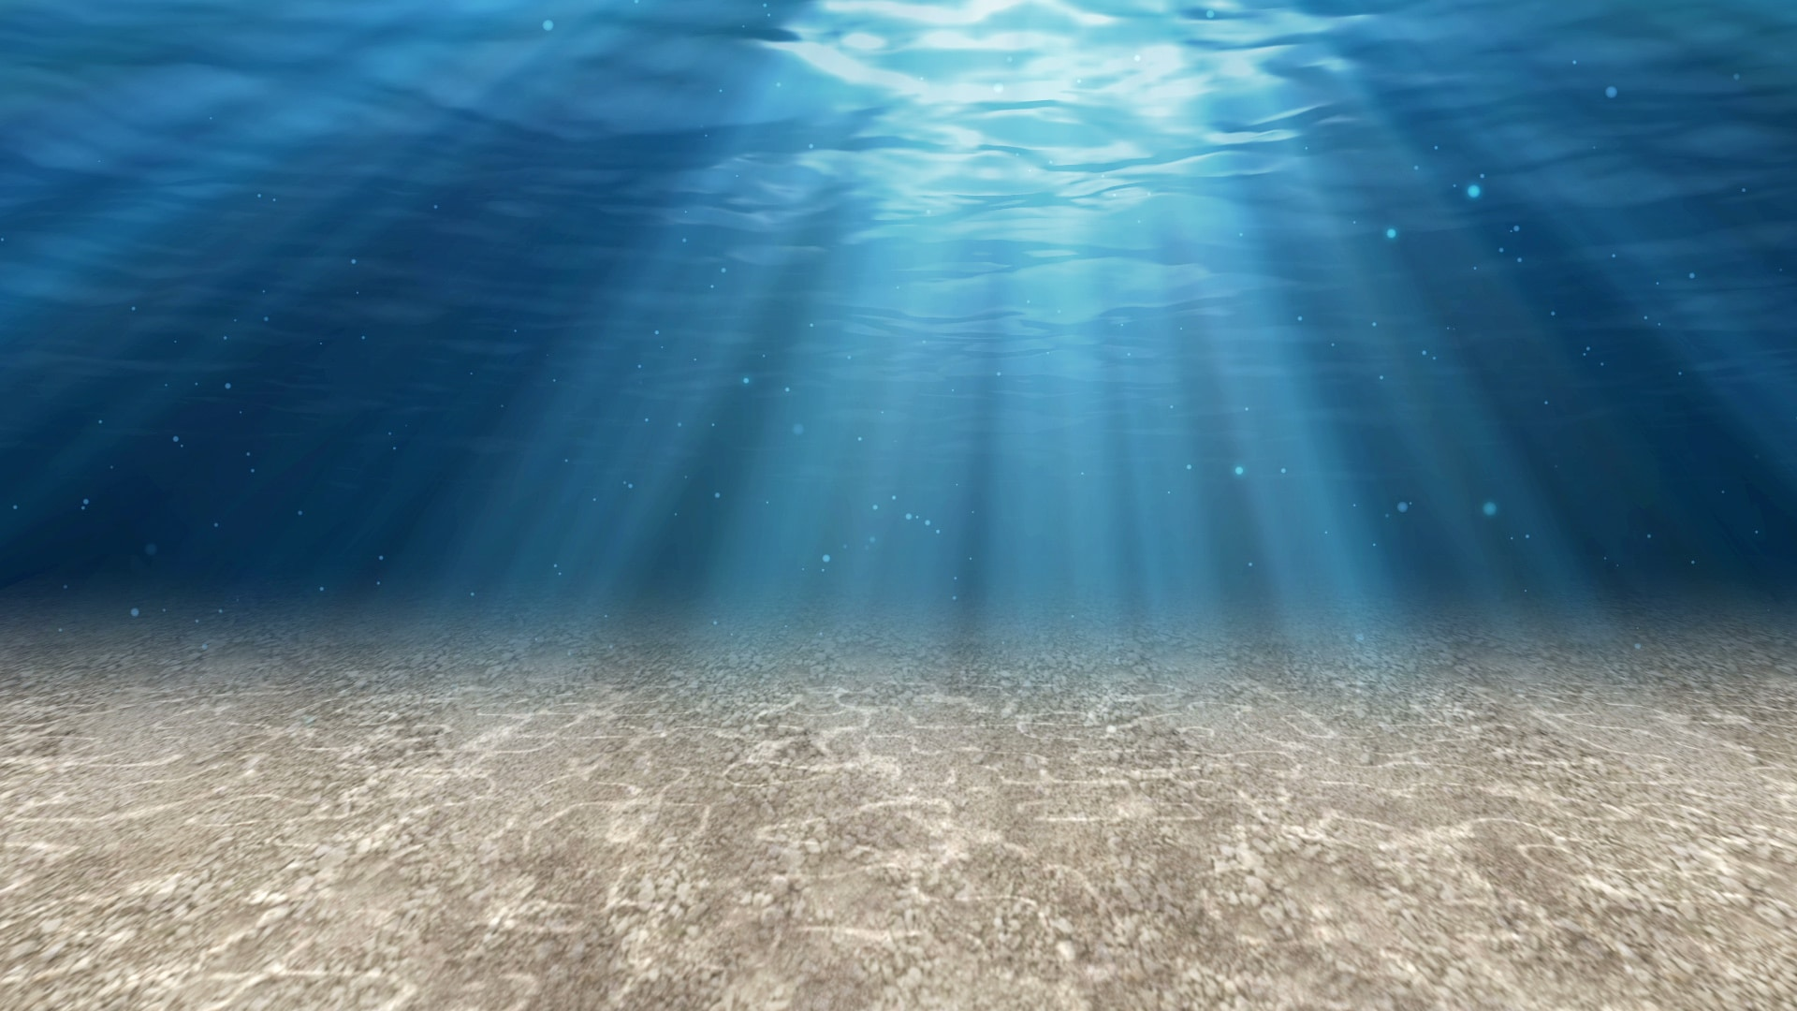
What animals live in the sea?

Slide 3
An octopus lives in the sea
Octopus like to live in the seawater. They live on the sea floor. They have eight legs.

Slide 4
Do octopus live in Irish waters?
No.
Octopus like to live in hot waters.

Slide 5
A crab lives in the sea
Crabs live in seawater. Some crabs do live in freshwater but most crabs live in the sea. Crabs walk sideways.

Slide 6
Do crabs live in Irish waters?
Yes.
Crabs live in saltwater in the Irish seas.

Slide 7
A seahorse lives in the sea
Seahorses like to live in seawater. Many seahorse can change colour to hide.

Slide 8
Do seahorses live in Irish waters?
Yes.
Some seahorse live in Irish seas but a lot of seahorse prefer to live in hot water.

Slide 10
What animals live in the river?

Slide 11
A turtle lives in the river
Many turtles like to live in freshwater but there are some turtles that live in the sea. Turtles have a hard shell on their backs.

Slide 12
Do turtles live in Irish waters?
Yes.
One type of turtle likes to live in the Irish seas.

Slide 13
An otter lives in the river
Otters like to live in freshwater. Some otters like to spend all their time swimming in water. They are very playful animals.

Slide 14
Do otters live in Irish waters?
Yes.
One type of otter likes to live in Irish rivers.

Slide 15
A frog lives in the river
Frogs like to live in freshwater. They lay eggs. They breathe through their nose and their skin.

Slide 16
Do frogs live in Irish waters?
Yes.
The common frog lives in Irish rivers.

Slide 17
What animals live in the pond?

Slide 18
A pond snail lives in the pond
Pond snails like to live in freshwater. They have a yellowish-brown shell.

Slide 19
Do pond snails live in Irish waters?
Yes.
Pond snails live in Irish rivers.

Slide 20
A duck lives in the pond
A lot of ducks like to live on freshwater but some ducks like to live on seawater. Ducks like to eat plants, insects and worms.

Slide 21
Do ducks live on Irish waters?
Yes.
There are a lot of ducks that live in Ireland.

