Slide 1
Egypt and the Ancient Egyptians

Slide 2
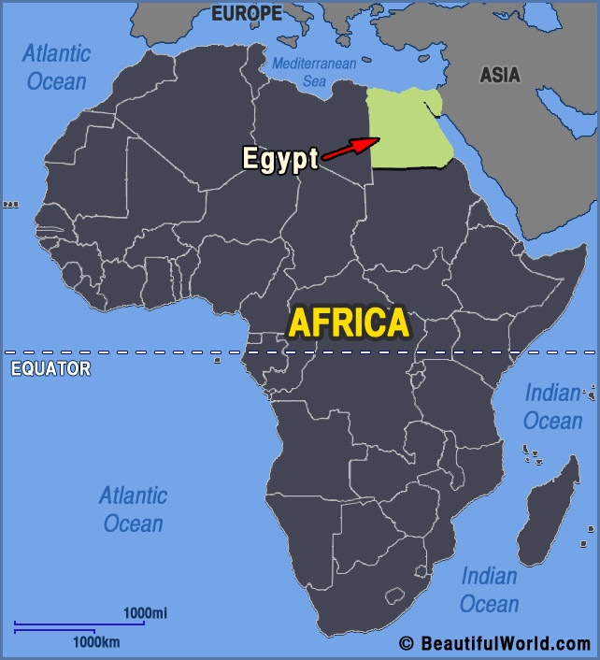
Egypt is in Africa.
It is a very hot country.
Most of it is sandy deserts where nothing grows.

Slide 3
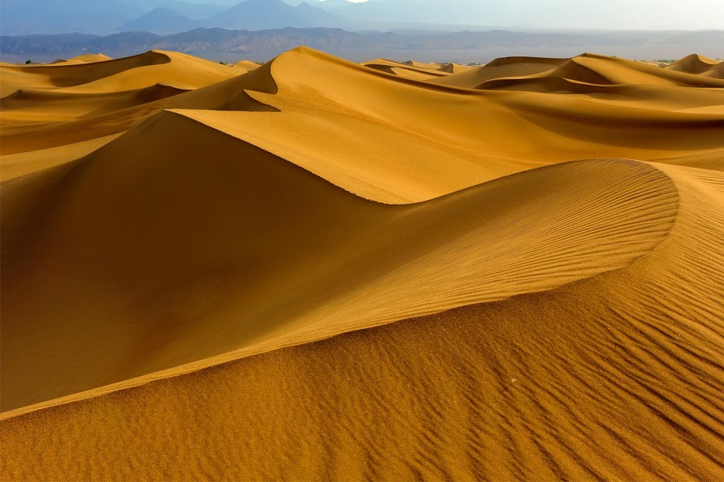

Slide 4
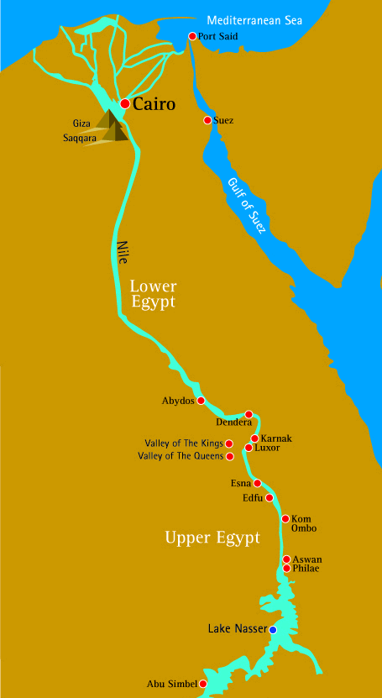
The only place where things really grow is beside the River Nile which flows right through Egypt.
A lot of people live near the river.
Egypt is very hot so they live beside the river to keep cool.
They can also get food from the river from fishing. The water also helps plants to grow.

Slide 5
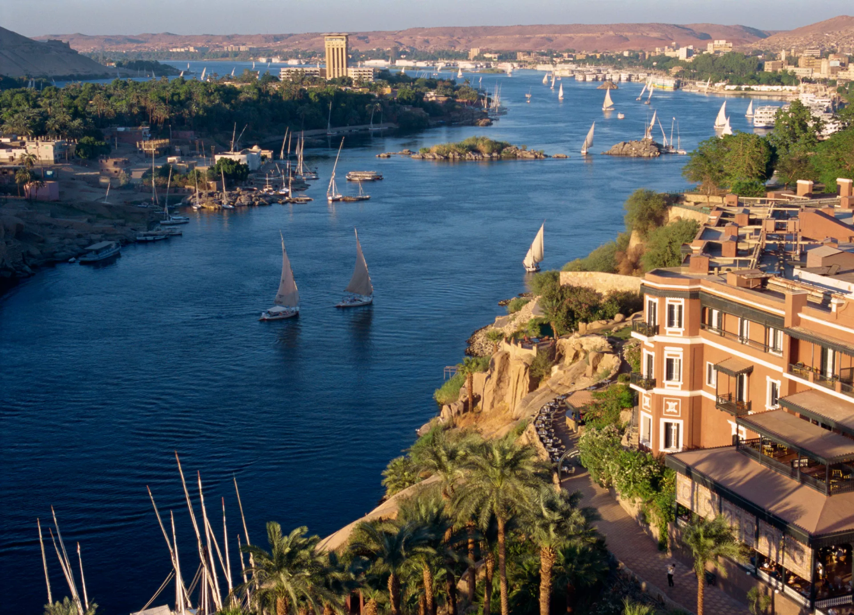
The River Nile

Slide 6
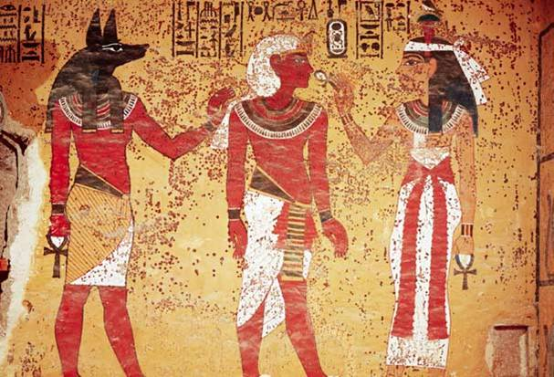
Ancient Egyptians
A long time ago in Egypt, there were people called the Ancient Egyptians.
They built many buildings that are still here today.
The Ancient Egyptians built the pyramids.

Slide 7
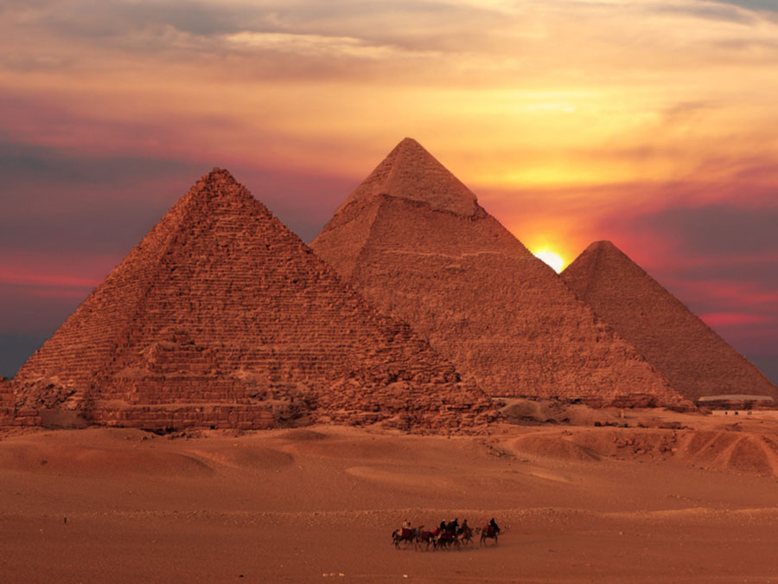
Pyramids

Slide 8
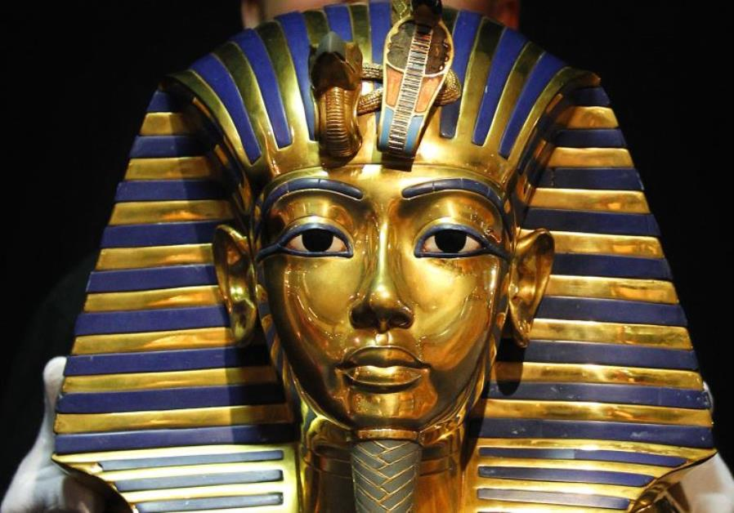
Pharaohs
The ruler of the Ancient Egyptians was the Pharaoh.
He was the richest and most powerful person in the land.
He tried to keep the Ancient Egyptians safe from their enemies.

Slide 9
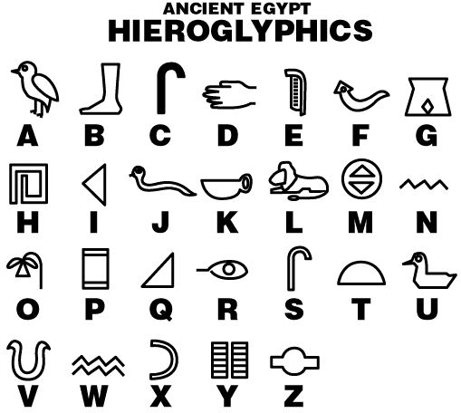
The Ancient Egyptians were one of the first group of people to ever use writing.
They drew pictures to write.
These pictures were called hieroglyphics.
Try writing your name in hieroglyphics.

Slide 10
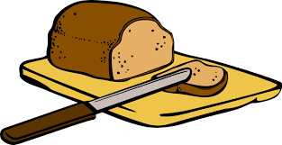
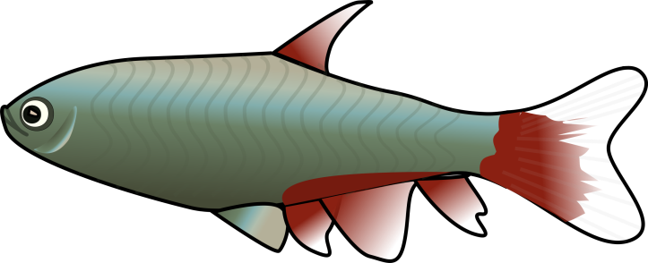
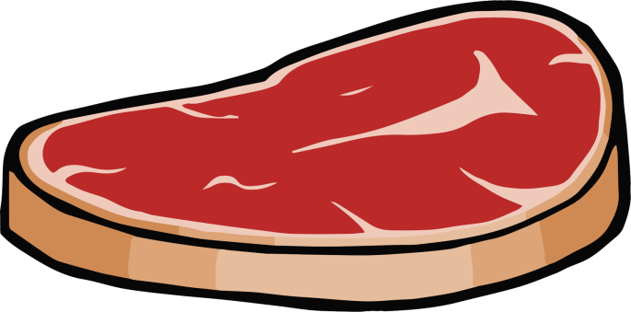
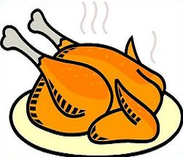
Food
All Ancient Egyptians ate bread and fish.
Only a few people who were rich, like the Pharaoh, could eat meat and chicken because these were expensive to buy.

Slide 11
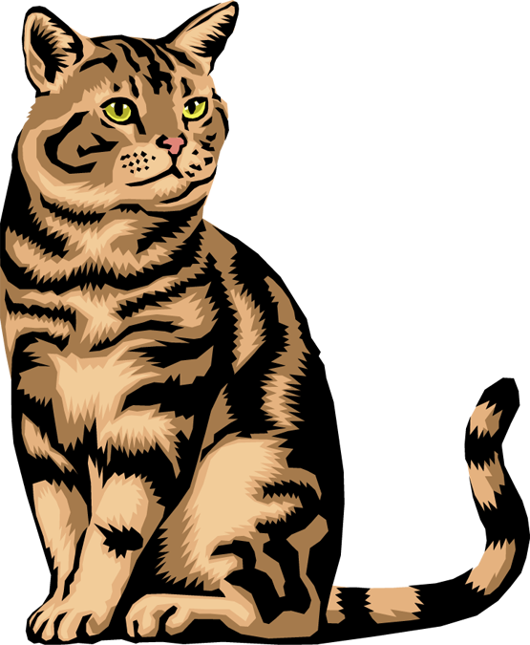
Cats
Cats were sacred and holy to Ancient Egyptians.
They loved cats.

Slide 12
What have we learned about Ancient Egypt?

